Slide 1
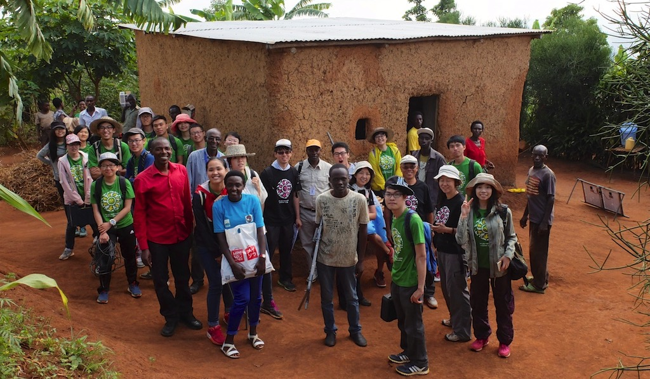


Con creditos reconocidos, Aprendiazaje-Servicio obligatorio en la Universidad Politécnica de Hong Kong
CLAYSS 2016
Dr. Stephen Chan
Director
Oficina de Aprendizaje-Servicio
HKPolyU
25 de agosto, 2016

Slide 2
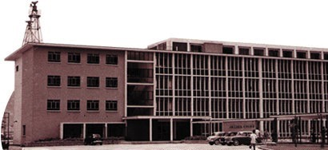
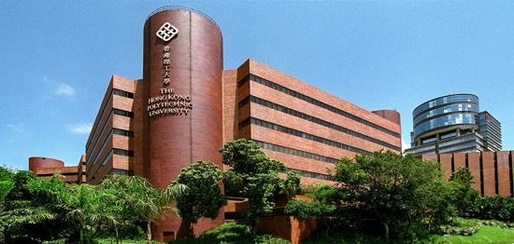
La Universidad Politécnica de Hong Kong
Historia remontada a1937
Gran alumnado (acogida anual de estudiantes: 2,800 estudiantes de primer año + otros 1,300 estudiantes avanzados = ~4,500)
Muchos son primera generación estudiantes universitarios
1970s
2016

Slide 3

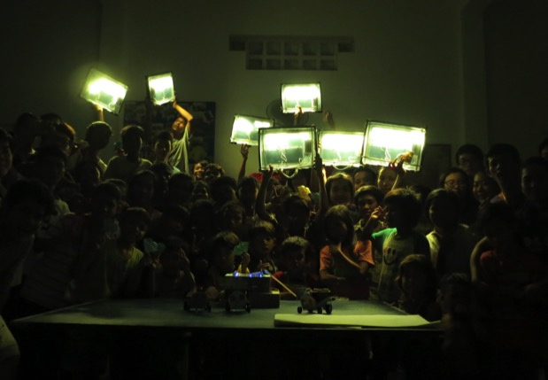
Core Strategy
Service-Learning = Service + Learning
All students have to pass at least one 3-credit service-learning subject before they can graduate, starting in 2012.

Slide 4

The Challenge:
All Service Learning Subjects have to achieve the following outcomes:
Apply the knowledge and skills to deal with complex issues in the service setting
Reflect on role and responsibilities as a professional and a responsible citizen
Demonstrate empathy for people in need
Demonstrate understanding of linkage between service and academic content of subject.
Lectures, Workshops, e-Learning
Service Project - At least 40 hours (1/3 of the course)
Reflection & Evaluation

Slide 5
Sample Workload of a SL Subject
e-Learning Module | 10 hours
Class Contact
Discipline-related Lectures, Tutorials, Seminars and/or Workshops | 10-15 hours
Project-Specific Seminars, Tutorials and/or Workshops | 10-15 hours
Reflection and review tutorials and sessions | 5-12 hours
Other student study effort:
Readings, self study, and planning and preparation for the service project | 30 hours
Direct rendering of service | 40 hours
Reflection and review | 25 hours
Total student study effort | 130-135 hours

Slide 6

Progress in Implementation
2011-12
2012-13
9
subject offerings
(pilot)
6
213
subject offerings
# of students
2013-14
183
# of students
38
2014-15
subject offerings
1,886
# of students
57
2016-17
(Full implementation)
subject offerings
3,014
# of students
(estimated)
2015-16 (Target)
~75
subject offerings
~4,500
# of students
~70
subject offerings
~4,000
# of students

Slide 7
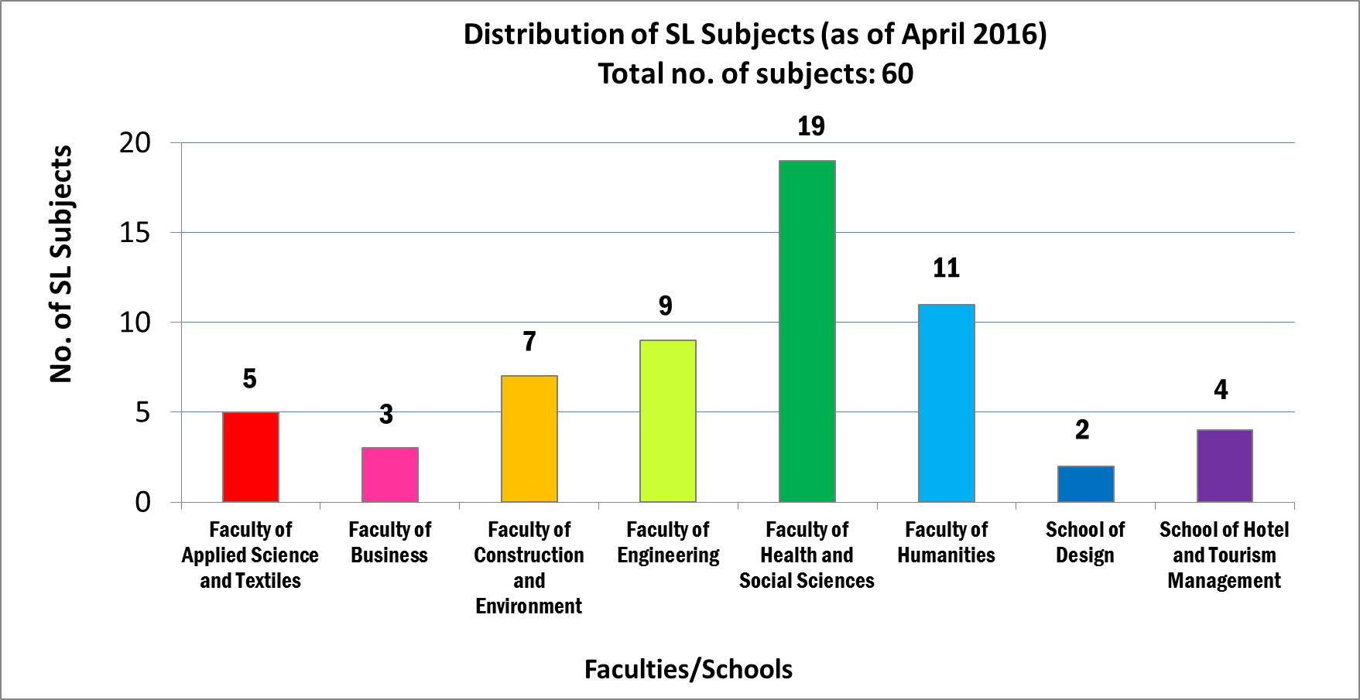
Approved Service-Learning Subjects

Slide 8
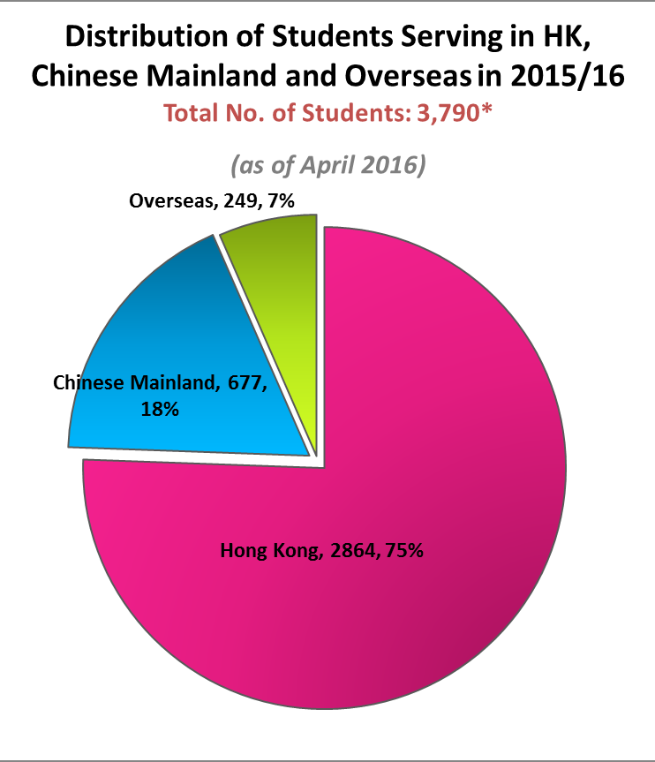
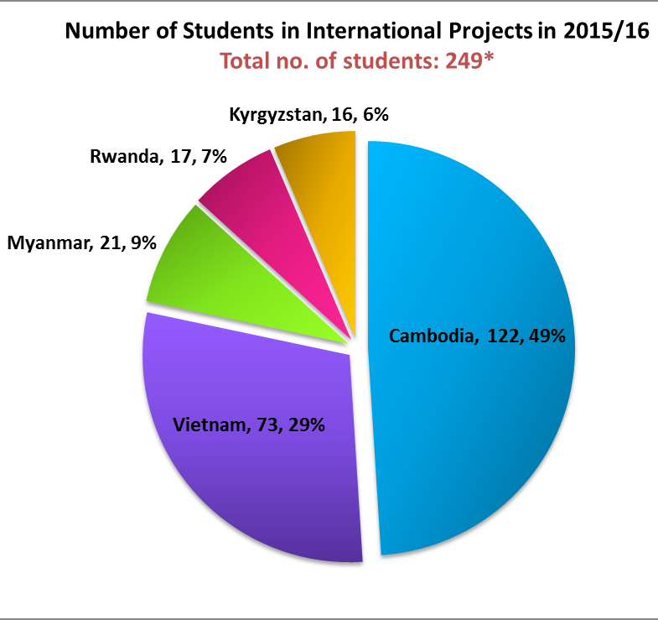
Where do students serve?

Slide 9
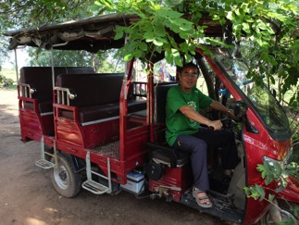
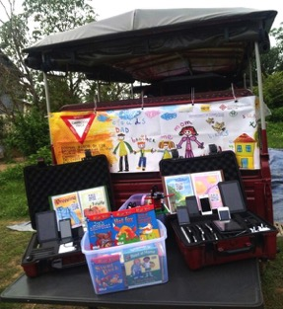
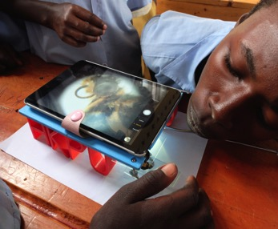
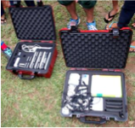
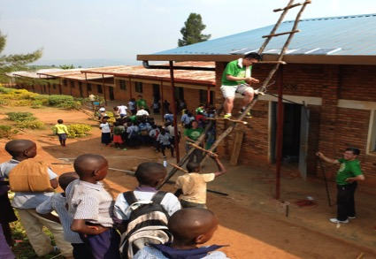
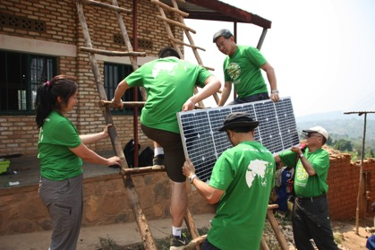
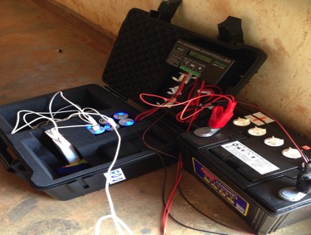
Computers, Internet and Power
Mobile computer laboratory for “off-the grid” developing communities
Access to Internet
Solar-electrical power
Community learning centers, with e-resources
Training for and transfer of knowledge to local youths and teachers.
Deployed in Cambodia, Rwanda, Myanmar.
12

Slide 10
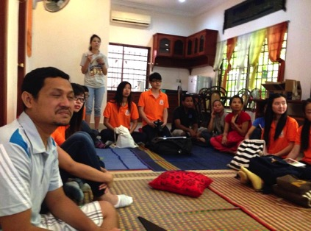
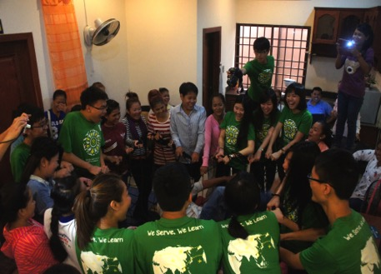
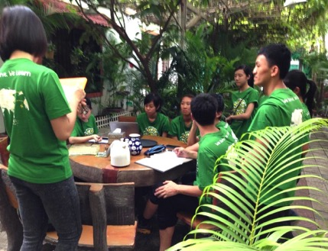
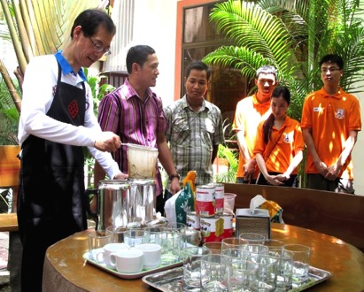
Hospitality Management — Hotel and Tourism
Conducted case study and consultation for guest houses run by social enterprise: budgeting, workflow, marketing, catering, housekeeping.
Training for hospitality schools.
Development of local tourism programs, such as homestay in villages.
Mainland China, Cambodia, Vietnam.

Slide 11
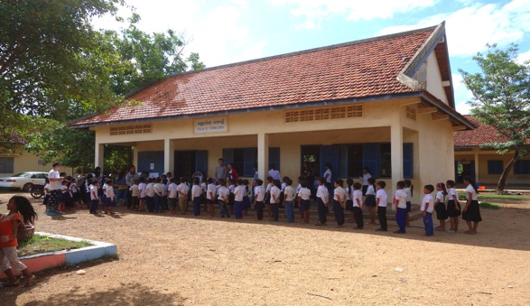
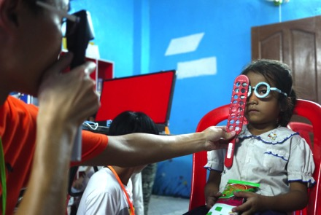
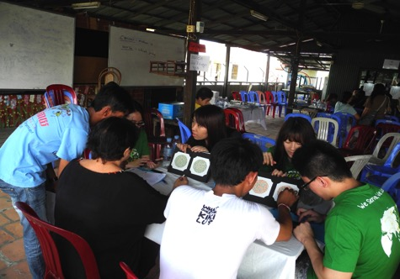
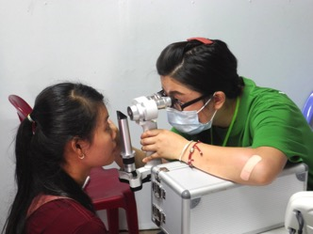
Vision Screening — Optometry
Preliminary visual screening
Eye care education
Seek sponsorship for spectacles dispensing for people in need.
Locations: Hong Kong, Guangxi, Qinghai, Xinjiang, Sichuan, Cambodia, Vietnam

Slide 12
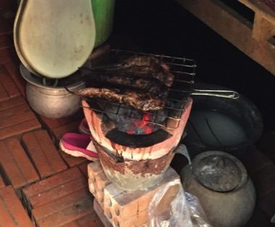
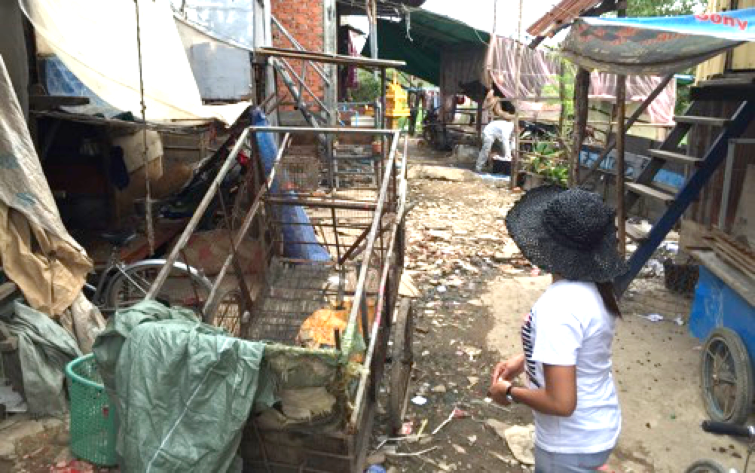
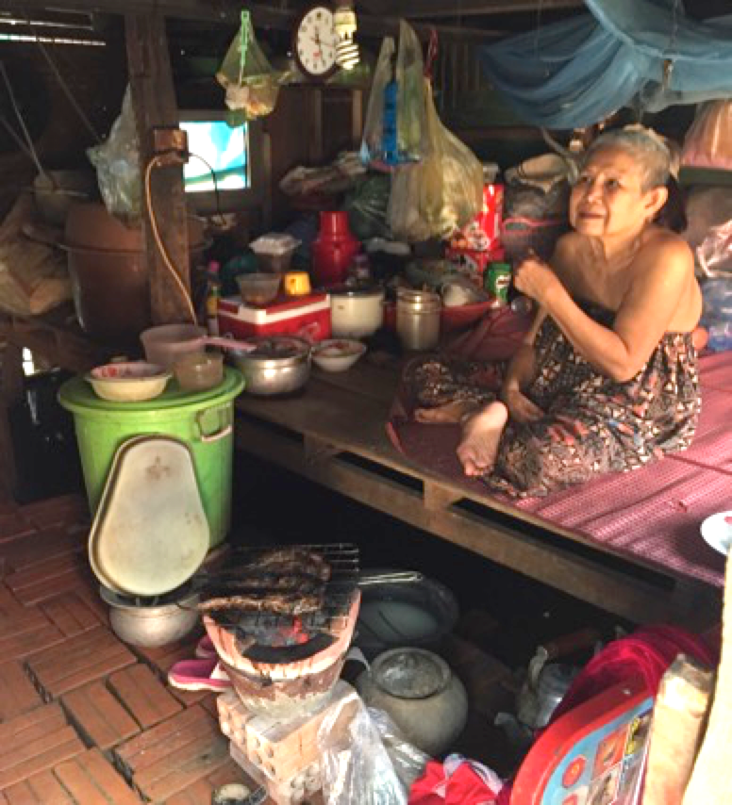
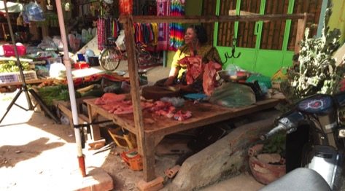
Healthy Lifestyle Challenges for Developing Communities - Nursing
Improving the eating habits of underpriviged communities
Served: families living in slums in Phnom Penh, Cambodia and villagers in rural Vietnam
Interview, study markets, make proposal and introduce to families

Slide 13
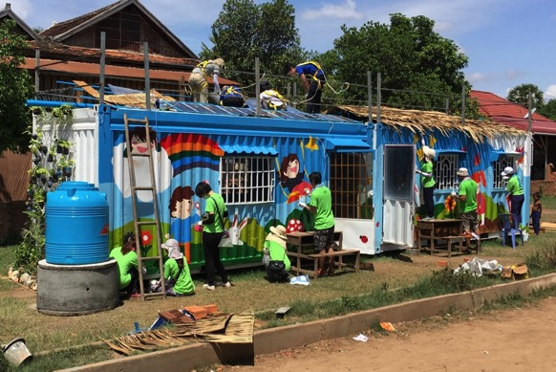
Global Service-Learning Scheme 2016 University Social Responsibility Network
Construction of solar-electrical powered community learning center in Cambodia using 2 used cargo containers (~80 students in total)
PolyU (HK) – 40 students
Royal University of Phnom Penh (Cambodia) – 10 students
HRDI (community college, Cambodia) – 20 students
Washington U (USA) in St Louis – 4 students
U of Haifa (Israel) – 2 students
Sichuan U (China) – 2 students
Brown U (USA) – 3 student journalists

Slide 14
Second International Conference on Service-Learning (ICSL 2016) 1-2 December, 2016, Hong Kong Polytechnic University, Hong Kong
Early bird registration: 31 August, 2016
Regular registration: 15 October, 2016
Conference website: http://www.osl.polyu.edu.hk/ICSL2016/

